Slide 1
Everyone Deserves SuprFanz.
Unique technologies to drive traffic to events via social media.

Slide 2
Agenda
Introductions
Ray Bernard (aka Cosmic Ray) Founder CEO
Jen Doyon Founder
How did Suprfanz come about?
What can Suprfanz for you?
What can you do for Suprfanz!

Slide 3
Introduction
Ray Bernard Aka Cosmic Ray.

Slide 4
Why Suprfanz?
20 hours plus a week working social media to try to folks to my shows!
Needed to find a way to target my Fan base.
Needed to figure way to try to sell out my shows!!

Slide 5
Fact about Facebook
In 20 minutes 1,484,000 event invites are posted.
25% of Facebook event creators are in Arts, Entertainment, Sports and Media.
Facebook revealed that there were 123 million events created in 2015 which suggests 336,986 events created per day.
25% of these is 84,247 potential uses.
Notes:
Presents a problem and an opportunity

Slide 6
What can Suprfanz do?
Suprfanz uses unique technology to drive fans to events via social media.
We do this in a very personalized active and thoughtful way at scale.
Suprfanz can do deep data analytics to discover the ‘SuprFanz’ within your social network

Slide 7
What can SuprFanz do?
Suprfanz grows an artist social network organically reaching out to targeted fan base and friending them.
Suprfanz can look at past events, targeting a similar fan base by email and instant messaging!!! If they are not your in your social network Suprfanz will actively make the request on your behalf.
Suprfanz saves an artist from 10 to 20 hours of social media work per week.

Slide 8
What can SuprFanz do?
Suprfanz uses best practice to in developing and nurturing your Fan base for you.
Suprfanz fanz will work for you based on the event location and within the best times to message your fans.

Slide 9
What can SuprFanz do?
SuprFanz work against your Fan or Business page and scrape the likes and retrieve contact details for a marketing campaign.
SuprFanz understands distance and the location of your event and will invite folks who live within a specific distance from your event.
** Suprfanz can leverage the power of the Band . We can go into each of the Band members Social media accounts and create a concerted proactive marketing campaign to target one event.

Slide 10
3 Ways Suprfanz today connects with Fans
1) Facebook Messenger
2) Email
3) SMS

Slide 11
Suprfanz Messaging
Personalized Facebook message & SMS (next version).
Over Messenger Chat.
Messages are use personal first name.
Messages geared toward the guest attendance status, dynamically

Slide 12
Suprfanz Email
Personalized Emails from Artist
Suprfanz Manage’s Artist Email List
Supfanz is setup using FB login

Slide 13
Twitter & Instagram next

Slide 14
Suprfanz Email

Slide 15
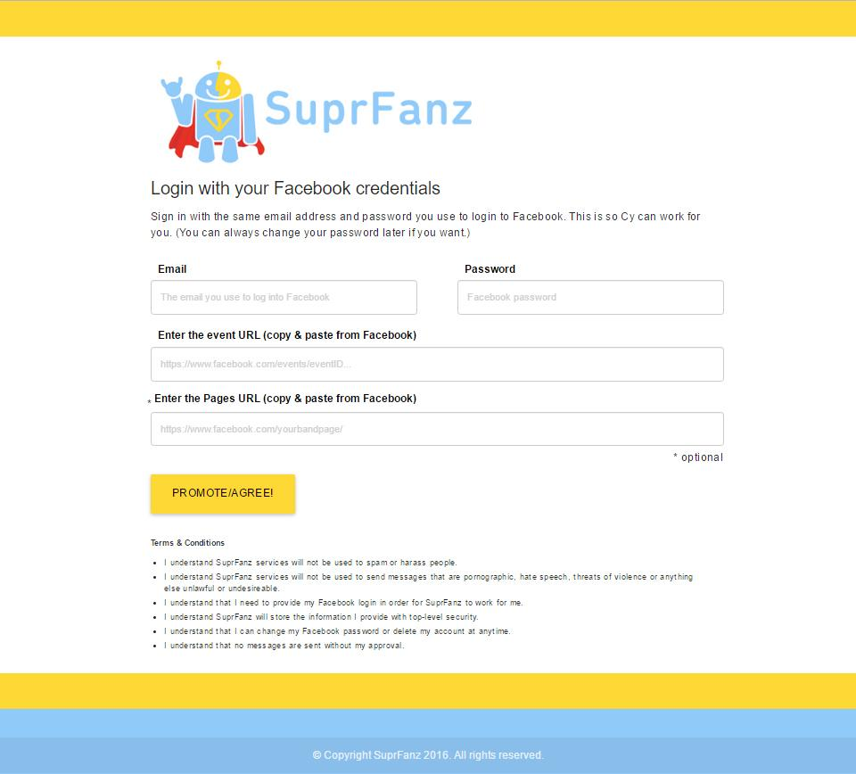
Beta v1

Slide 16
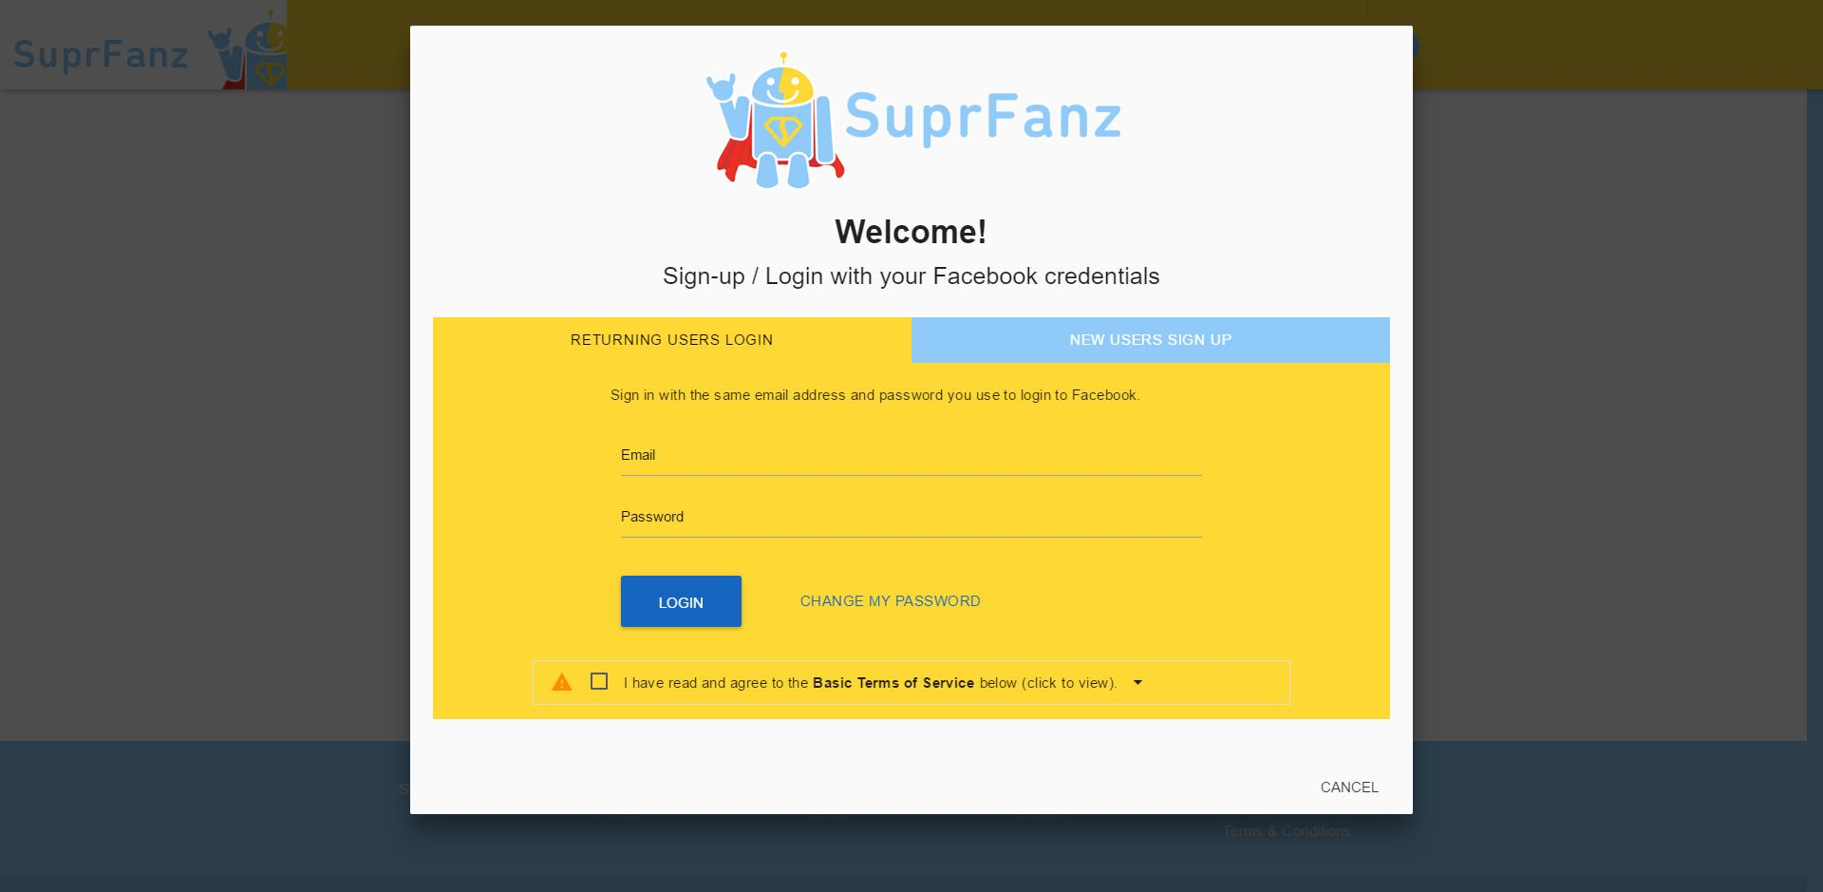

Slide 17
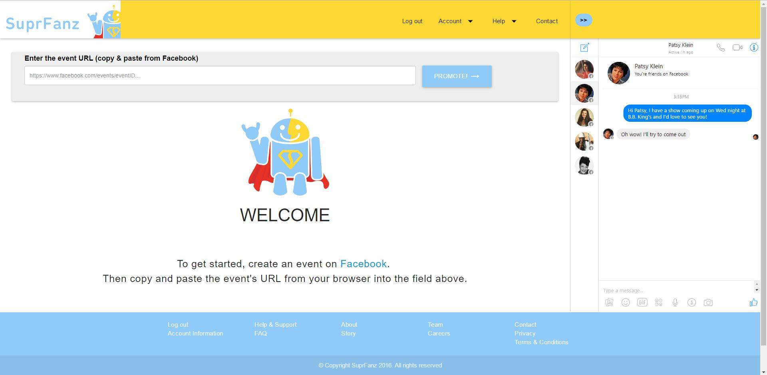

Slide 18
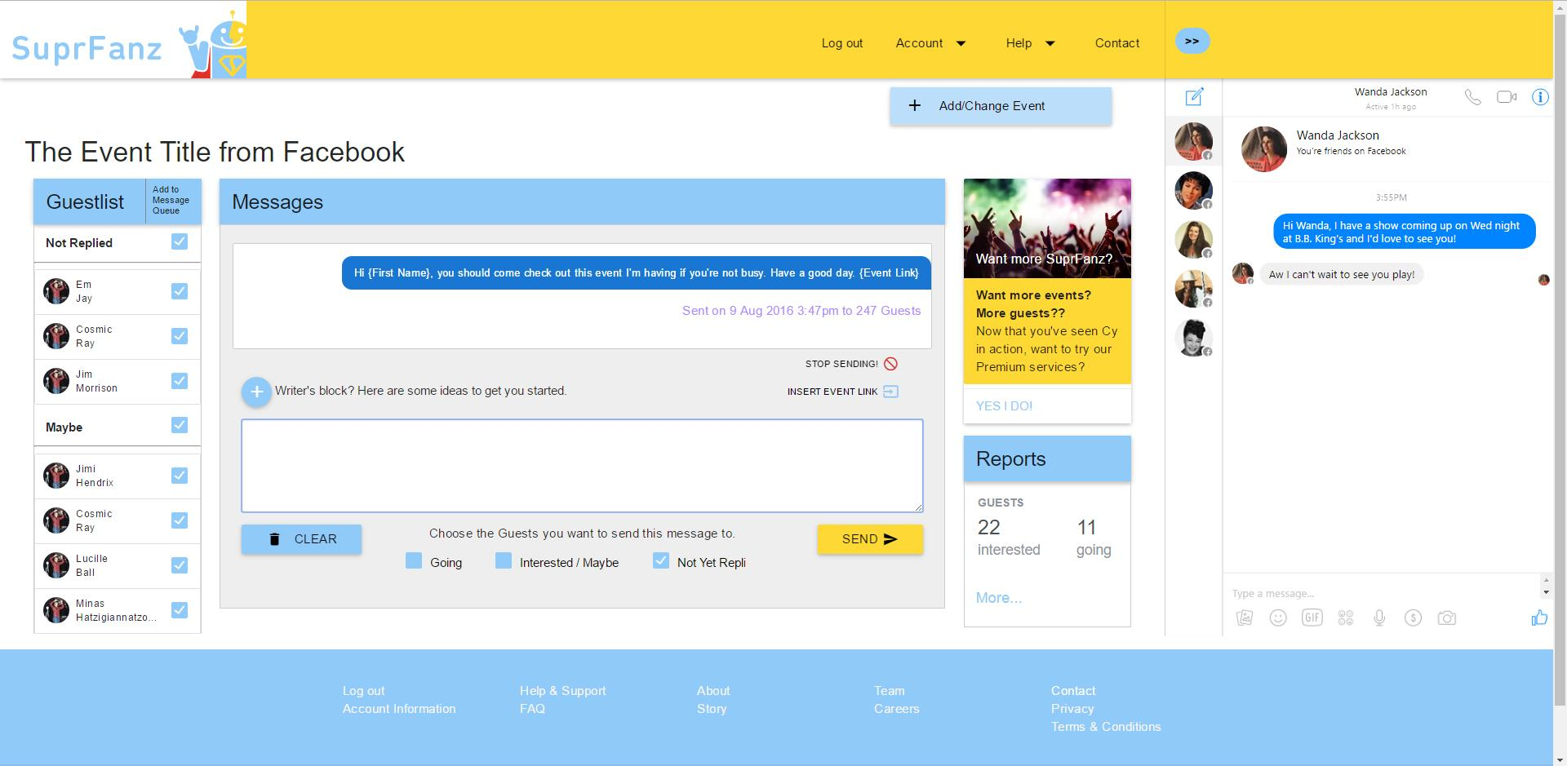

Slide 19
Next Section

Slide 20
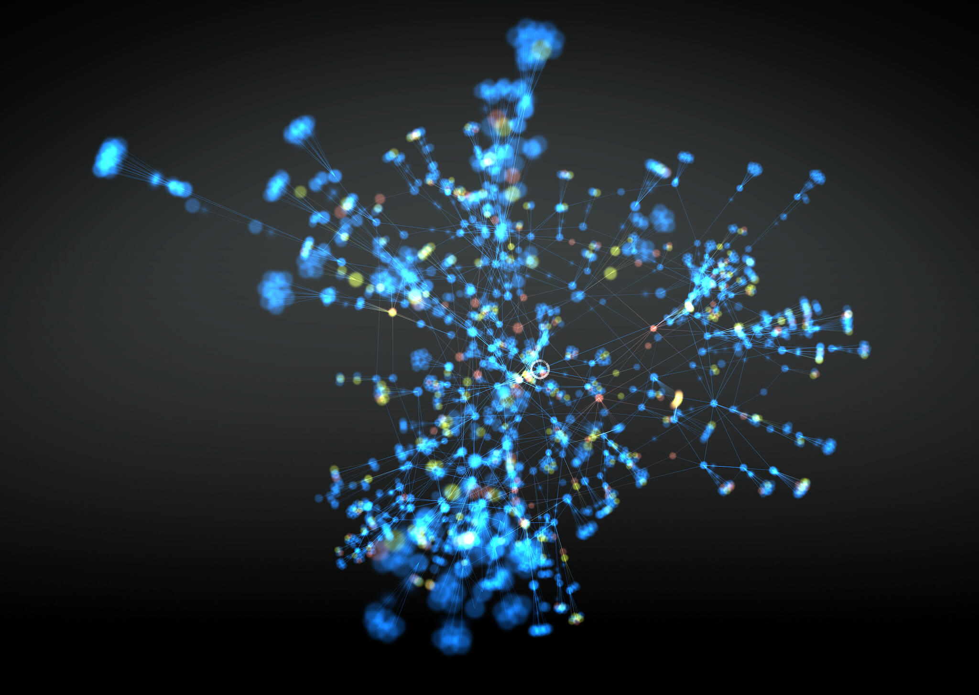
Introduction to Suprfanz
Helping Drive Fans to Events via Social Media

Slide 21
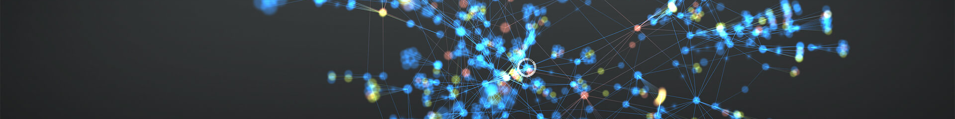

Slide 22
Next Section

